Slide 1

Cluster Analysis

Slide 2
General purpose
The concept of cluster analysis (introduced in Tryon, 1939) actually encompasses several different classification algorithms.
cluster analysis only detects structures in your data without explaining why they occur.
cluster analysis is a form of exploratory data analysis (EDA) where observations are divided into meaningful groups that share common characteristics (features) amongst each other.

Slide 3
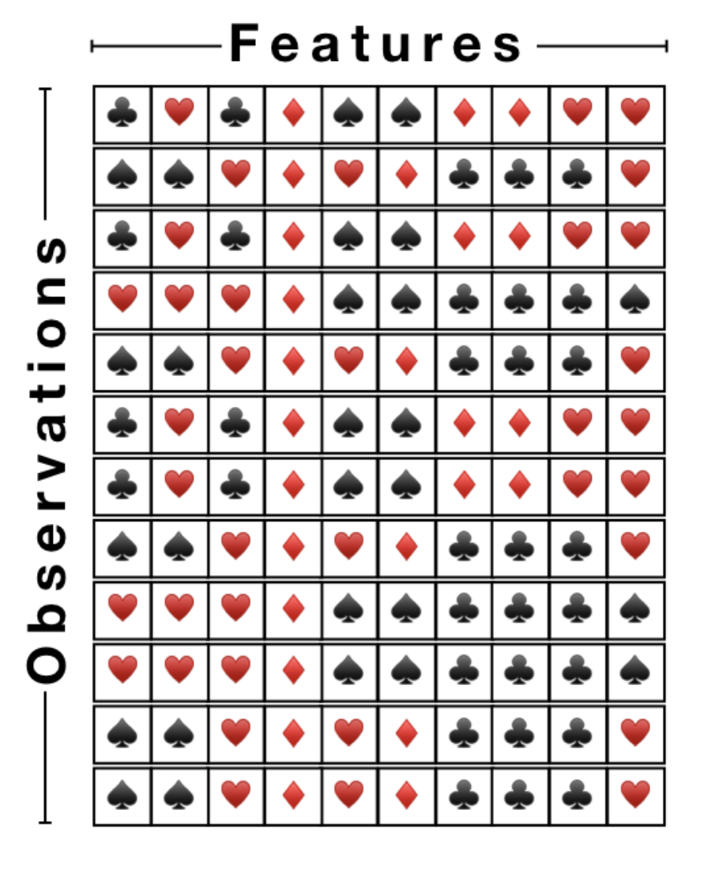
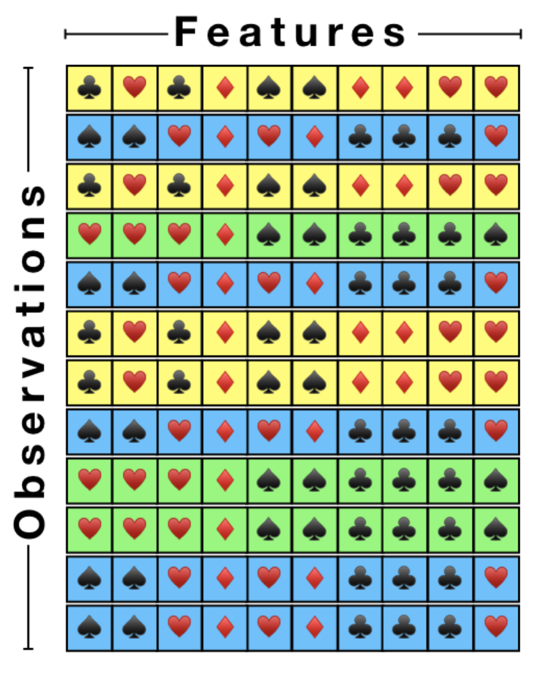
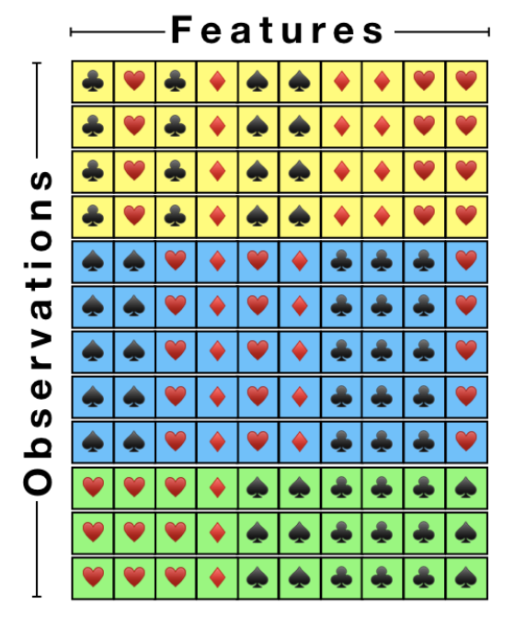
What is cluster analysis?

Slide 4
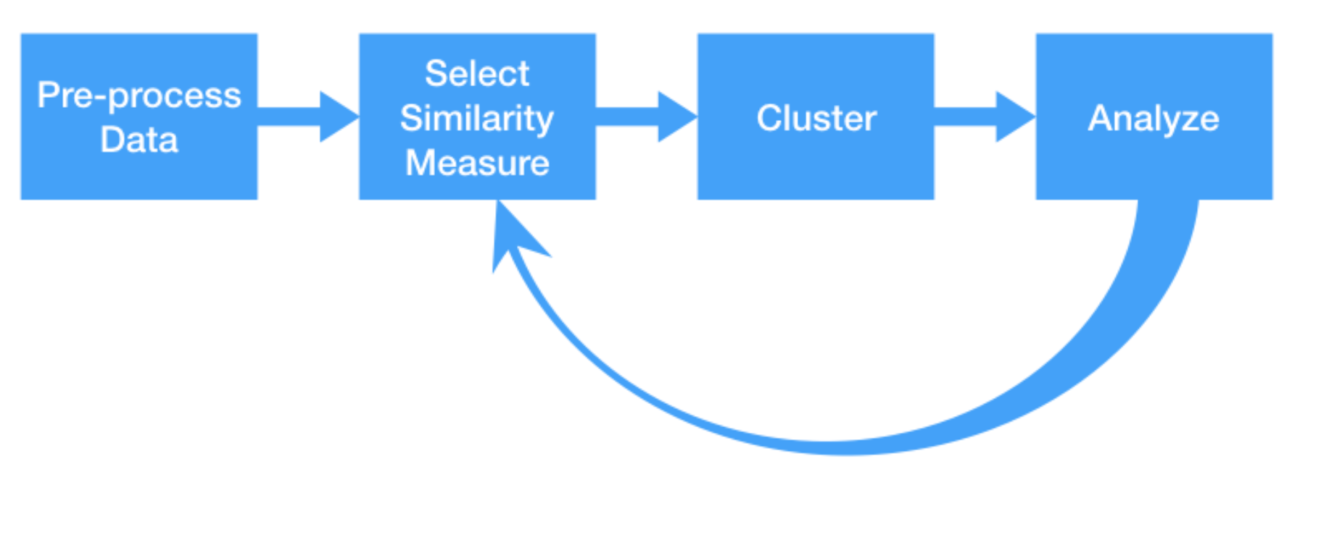
The flow of cluster analysis

Slide 5
Applications
Typical applications – As a stand-alone tool to get insight into data distribution – As a preprocessing step for other algorithms
Examples of Clustering Applications
Marketing segmentation
Pattern grouping
Land use
Insurance
City-planning
Earth-quake studies

Slide 6
Major Clustering Approaches
Partitioning algorithms
Hierarchy algorithms
Density-based
Grid-based
Model-based

Slide 7
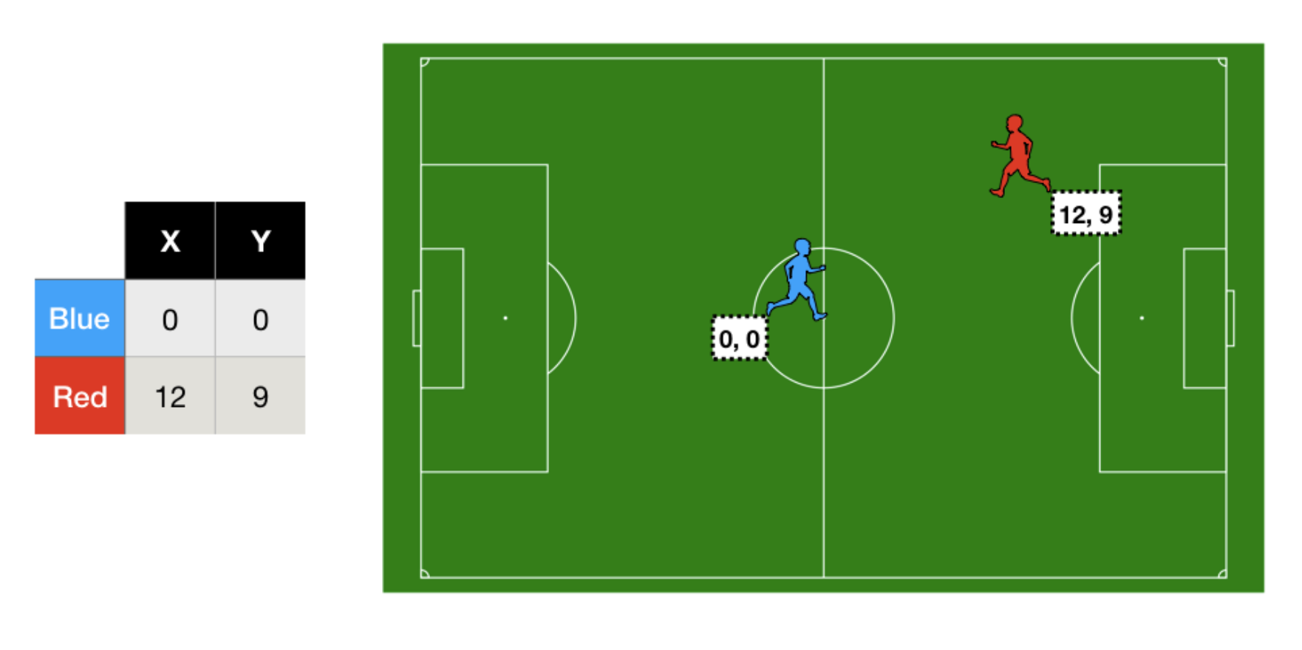
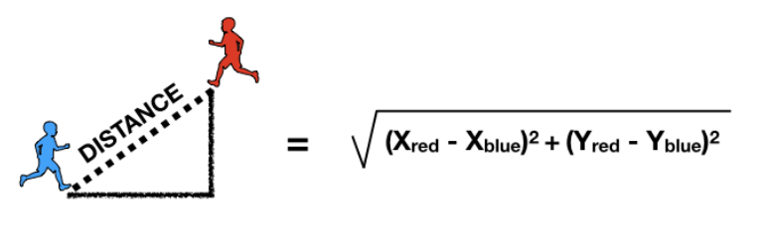
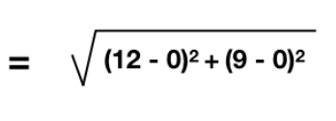
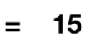
Distance between two observations
Distance = 1 - Similarity

Slide 8
Distance measures
In the agglomeration method, when forming clusters, measures of divergence or distance between objects are used. The most direct way to calculate the distance between objects in a multidimensional space is to calculate the Euclidean distance.
Square of the Euclidean distance. The Euclidean distance is squared to give more weight to objects that are further apart. It is calculated as follows:
distance(x,y) = { _{i} (x_{i} - y_{i})² }^{½}

Slide 9
Distance measures
City distance (Manhattan, City block). This distance is simply the sum of the differences measured along the dimensions. In most cases, this distance measure produces similar results to the normal Euclidean distance.
distance(x,y) = _{i} |x_{i} - y_{i}|

Slide 10
Distance measures
Chebyshev distance. distance(x,y) = Maximum|x_{i} - y_{i}|
Power distance.
Percentage mismatch.
distance(x,y) = ( _{i} |x_{i} - y_{i}|^{p})^{1/r}
distance(x,y) = (Liczba x_{i} y_{i})/ i

Slide 11
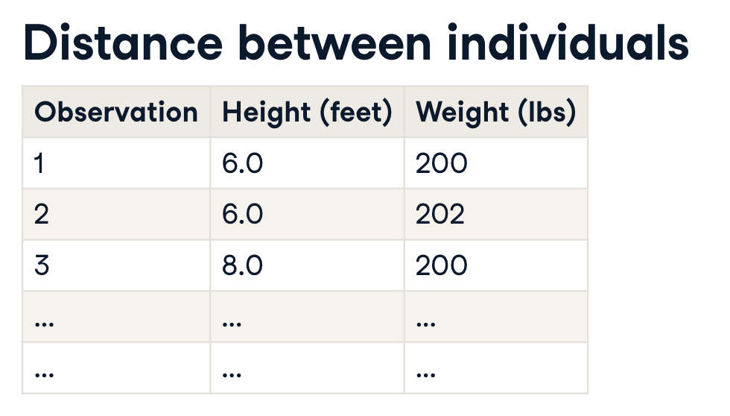
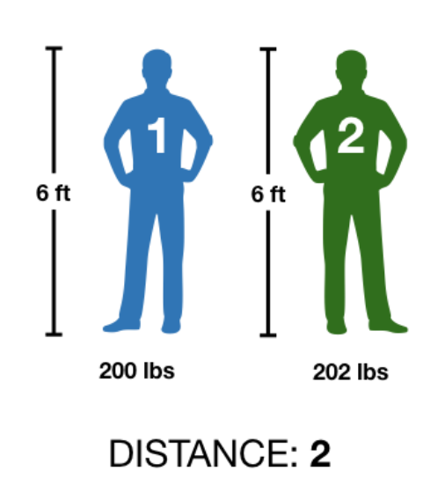
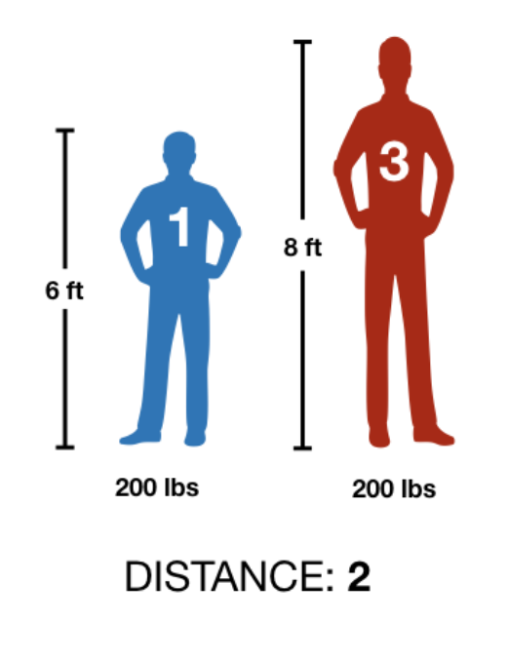
The importance of scale

Slide 12
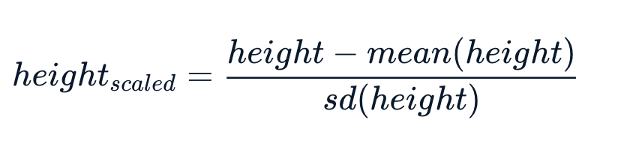
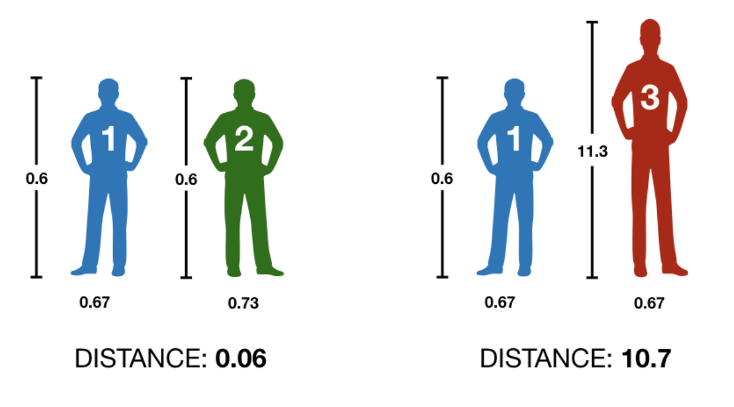
Scaling our features

Slide 13
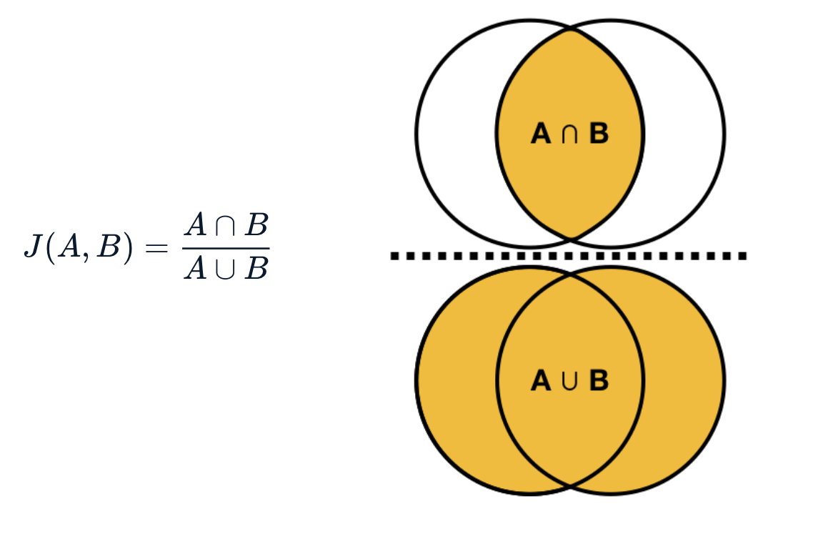
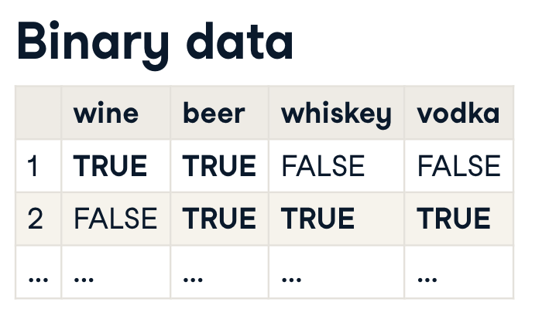


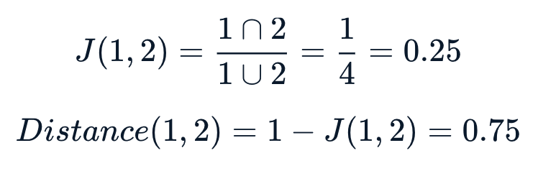
Measuring distance for categorical data

Slide 14
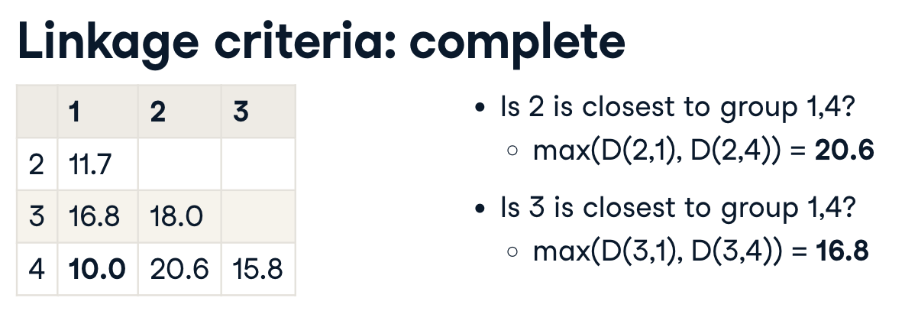
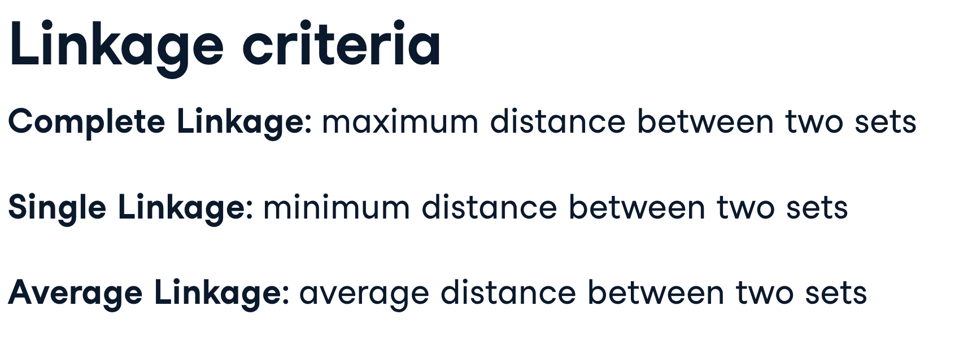
Comparing more than two observations

Slide 15
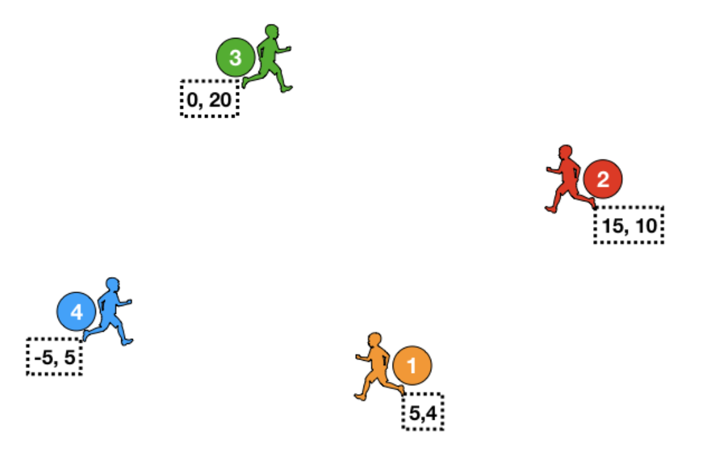
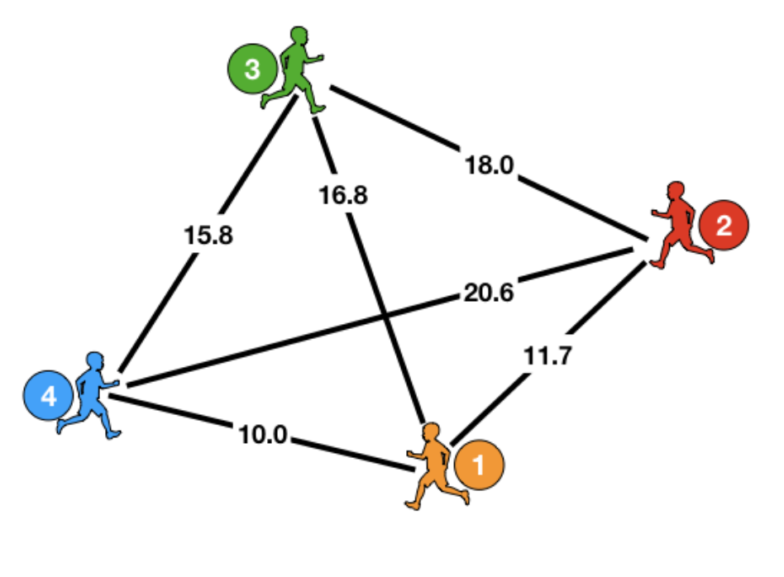
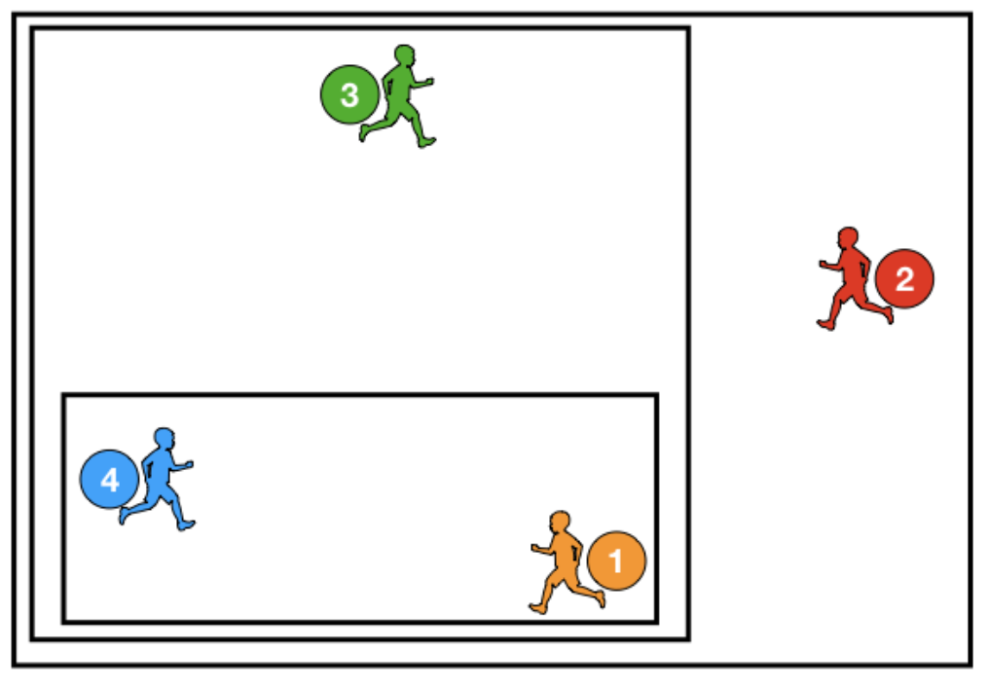
Hierarchical clustering (linkage criteria)

Slide 16
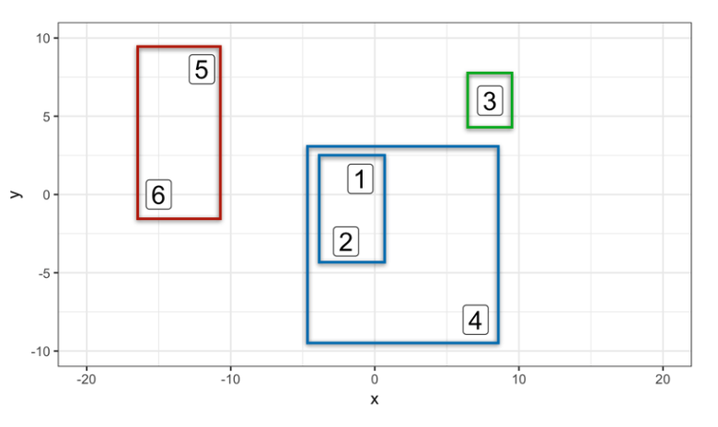
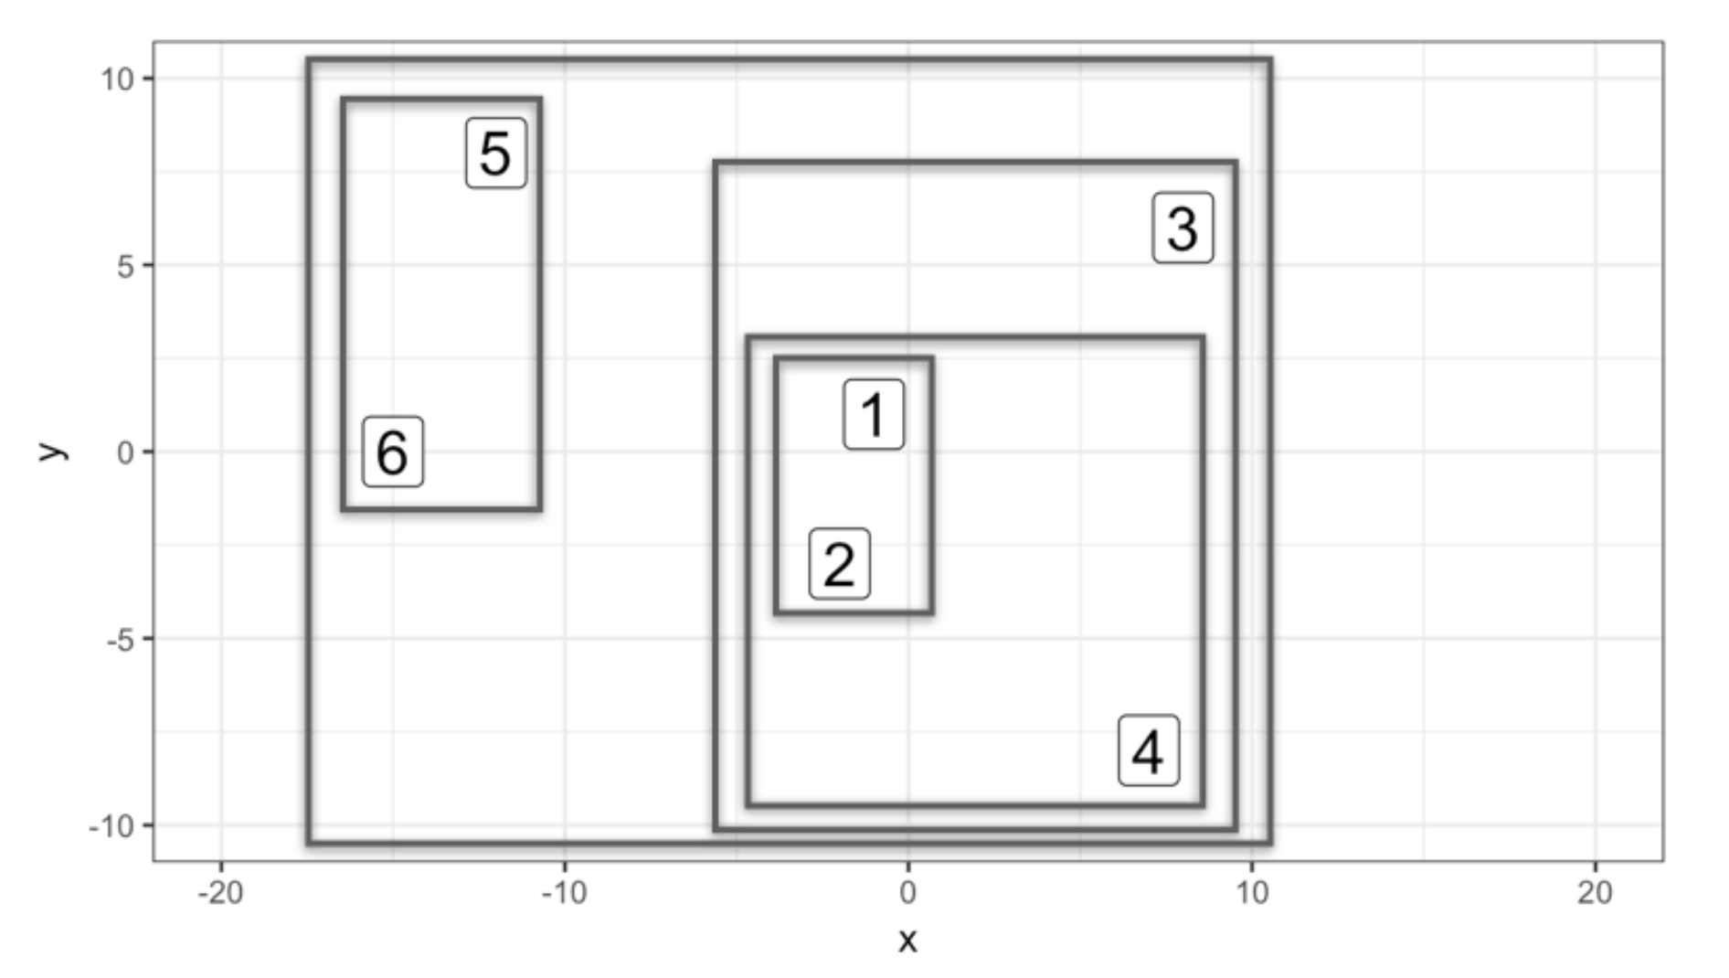
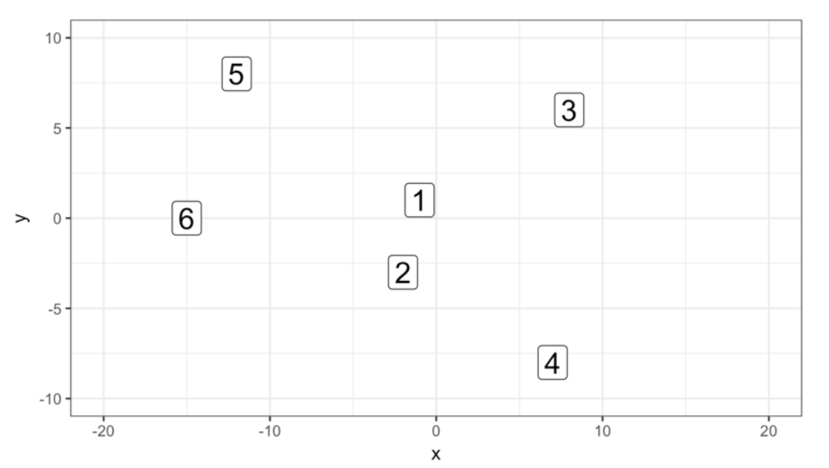
Hierarchical clustering (k clusters)

Slide 17
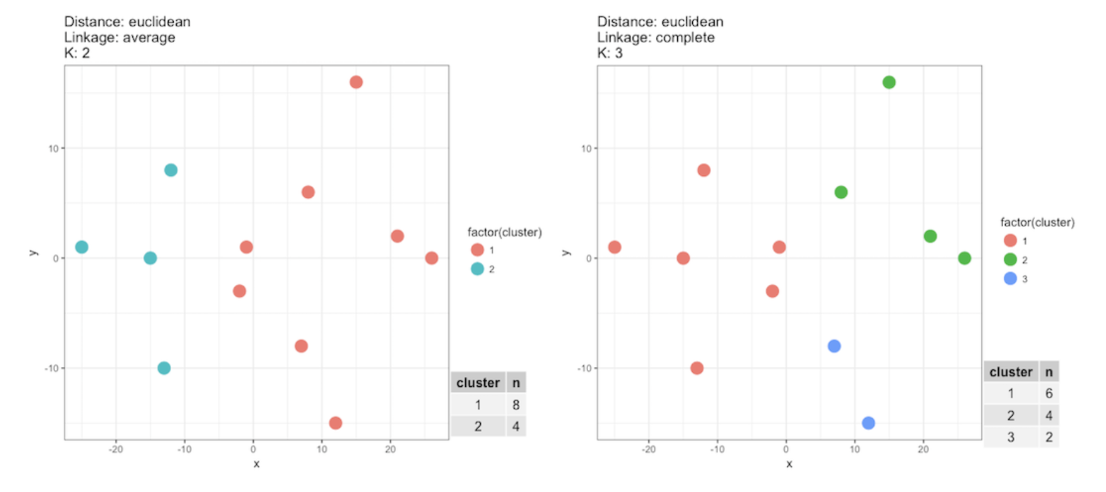
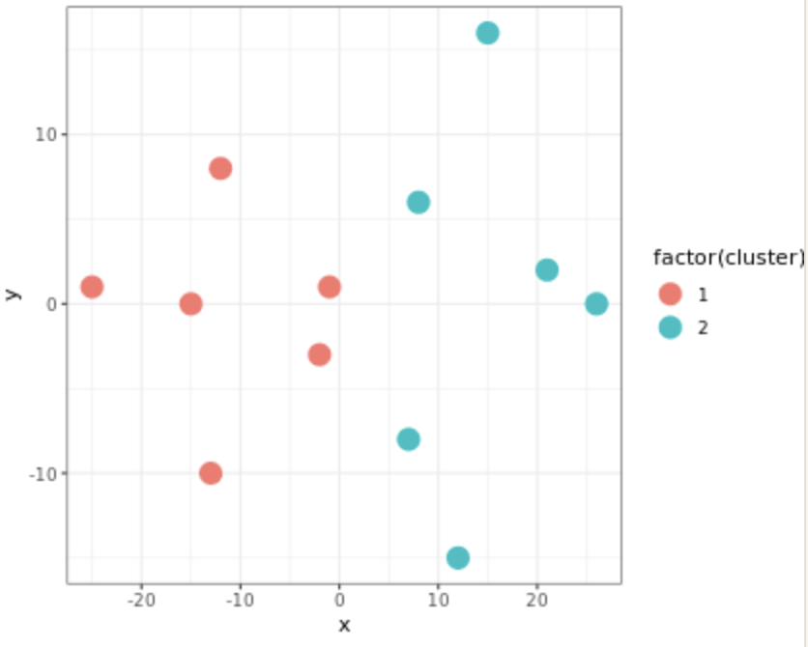
Hierarchical clustering (visualizing k clusters)

Slide 18
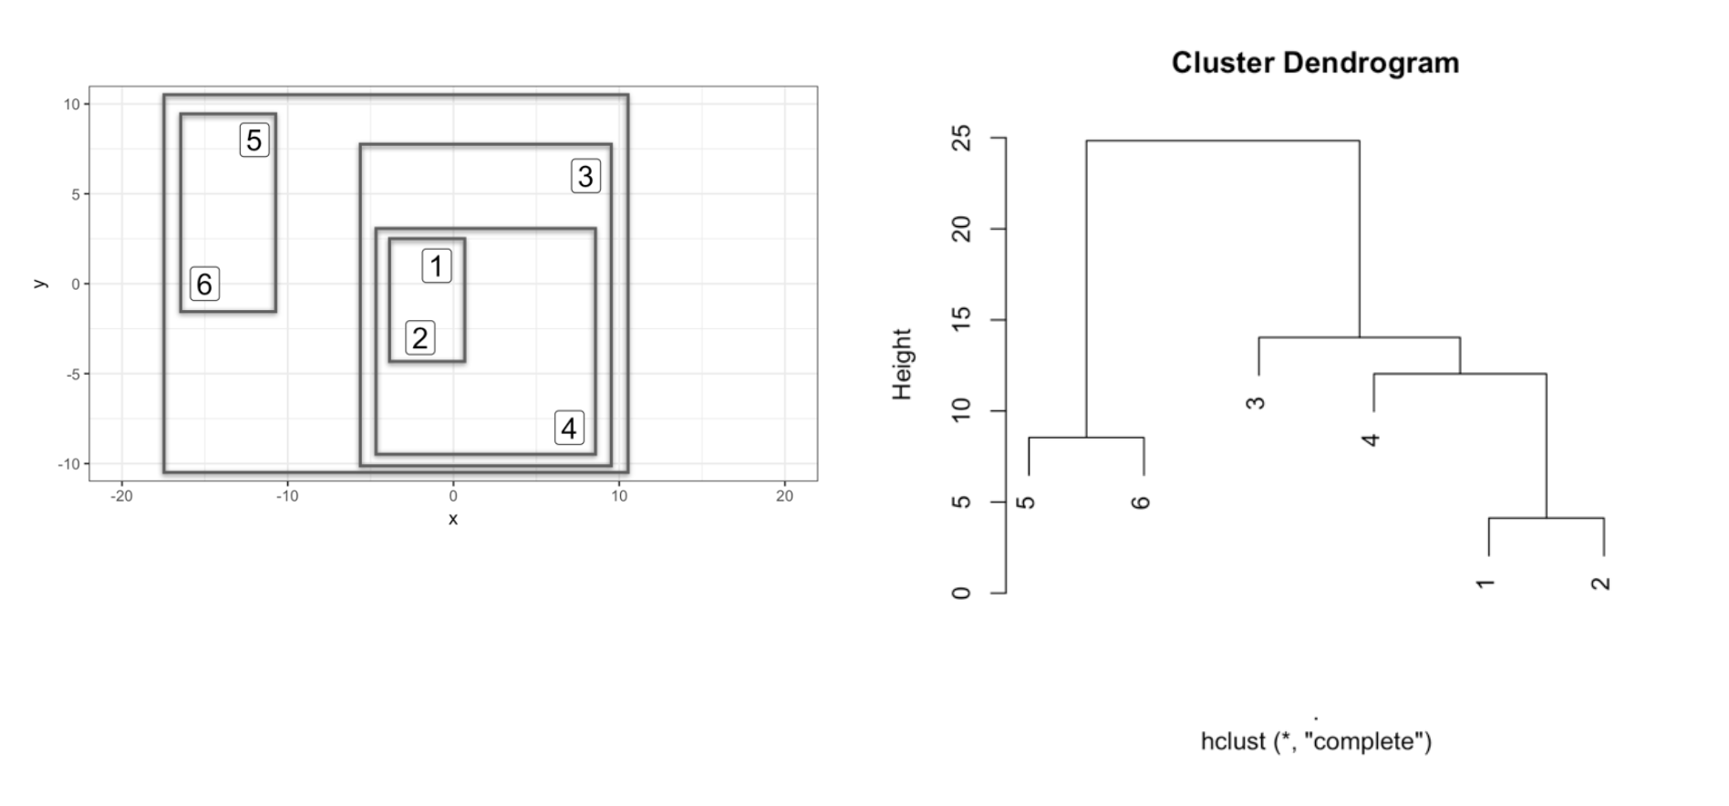
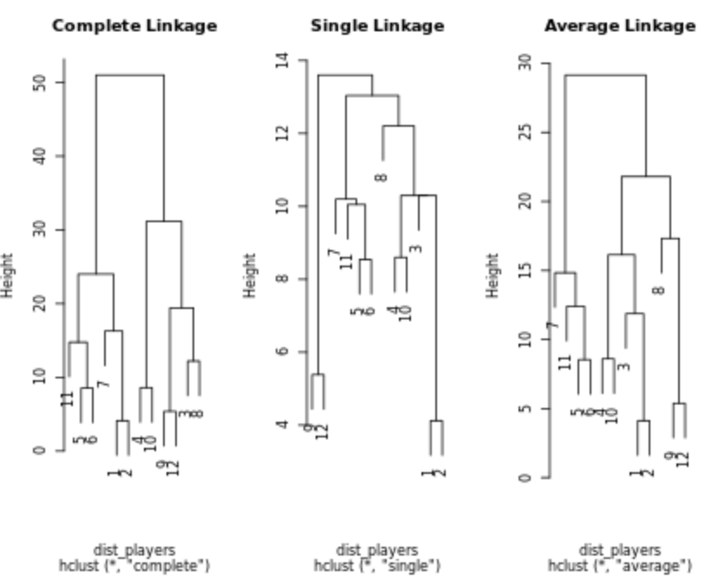
Hierarchical clustering (building dendrogram)

Slide 19
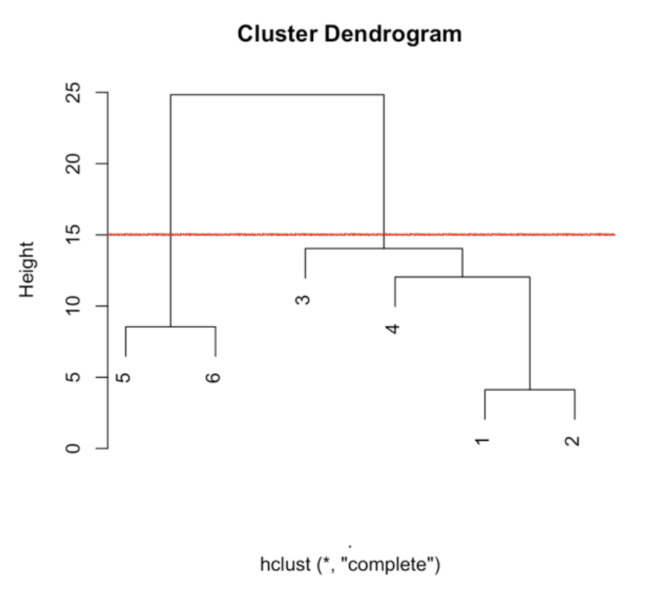
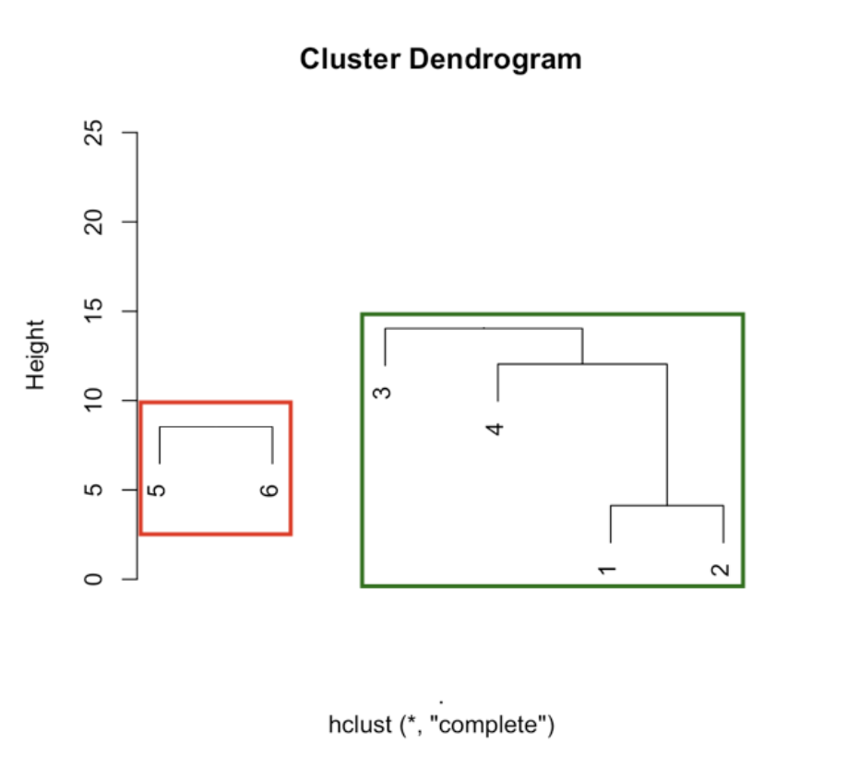
Hierarchical clustering (cutting the tree)

Slide 20
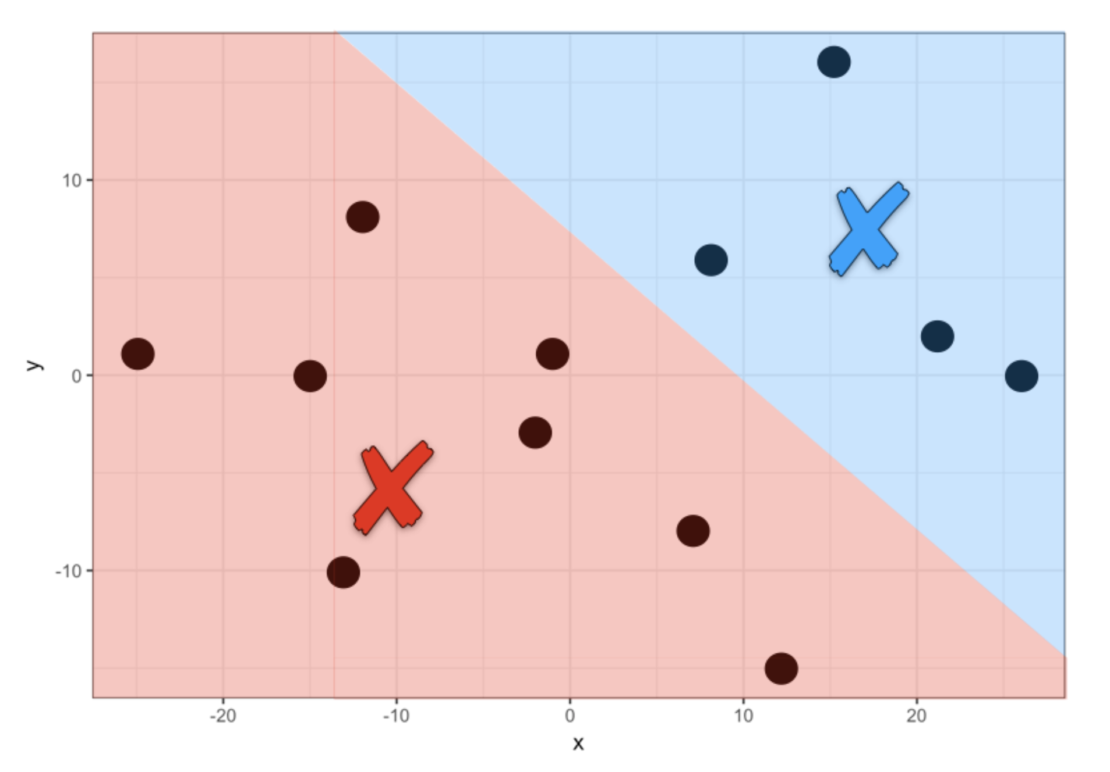
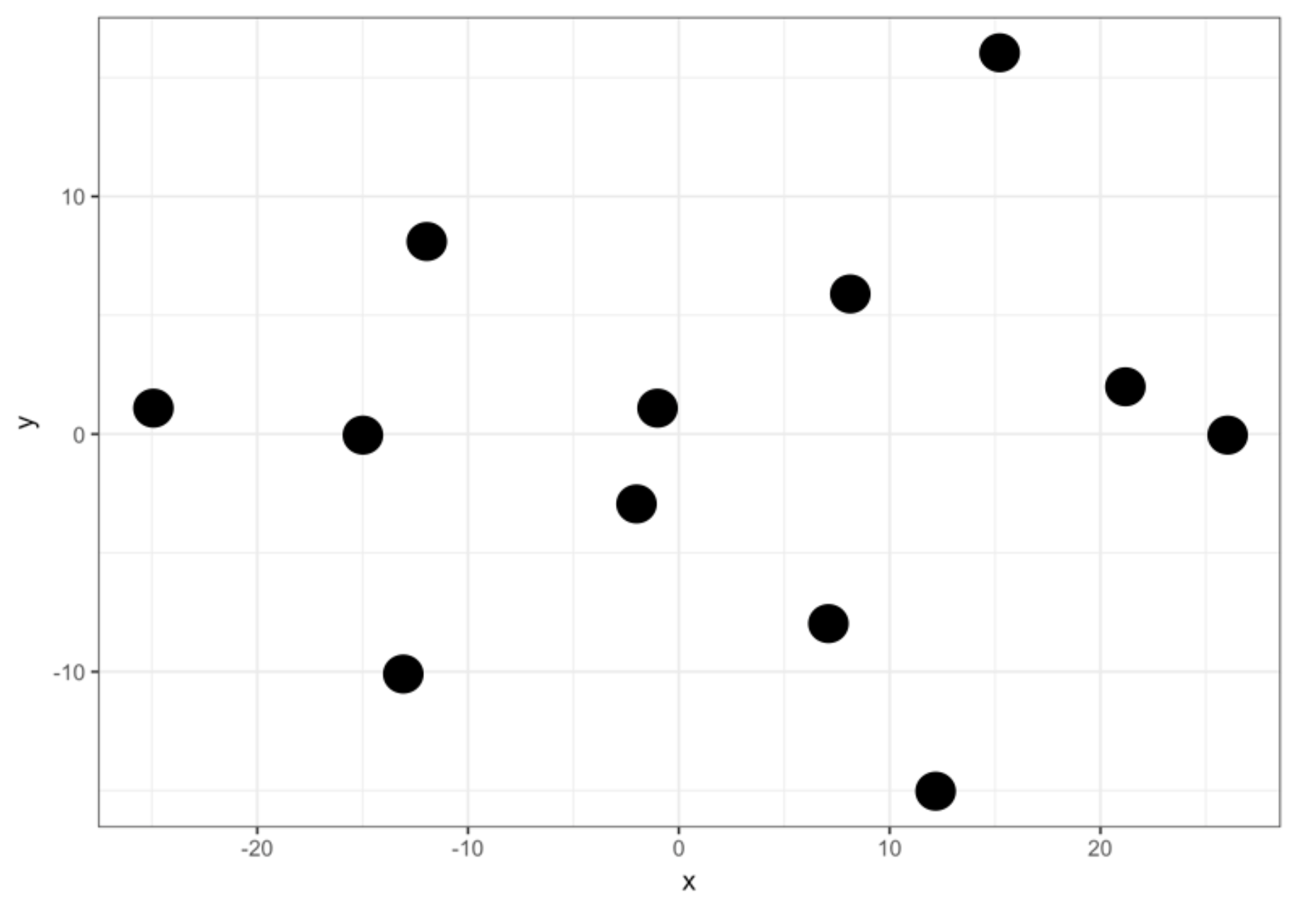
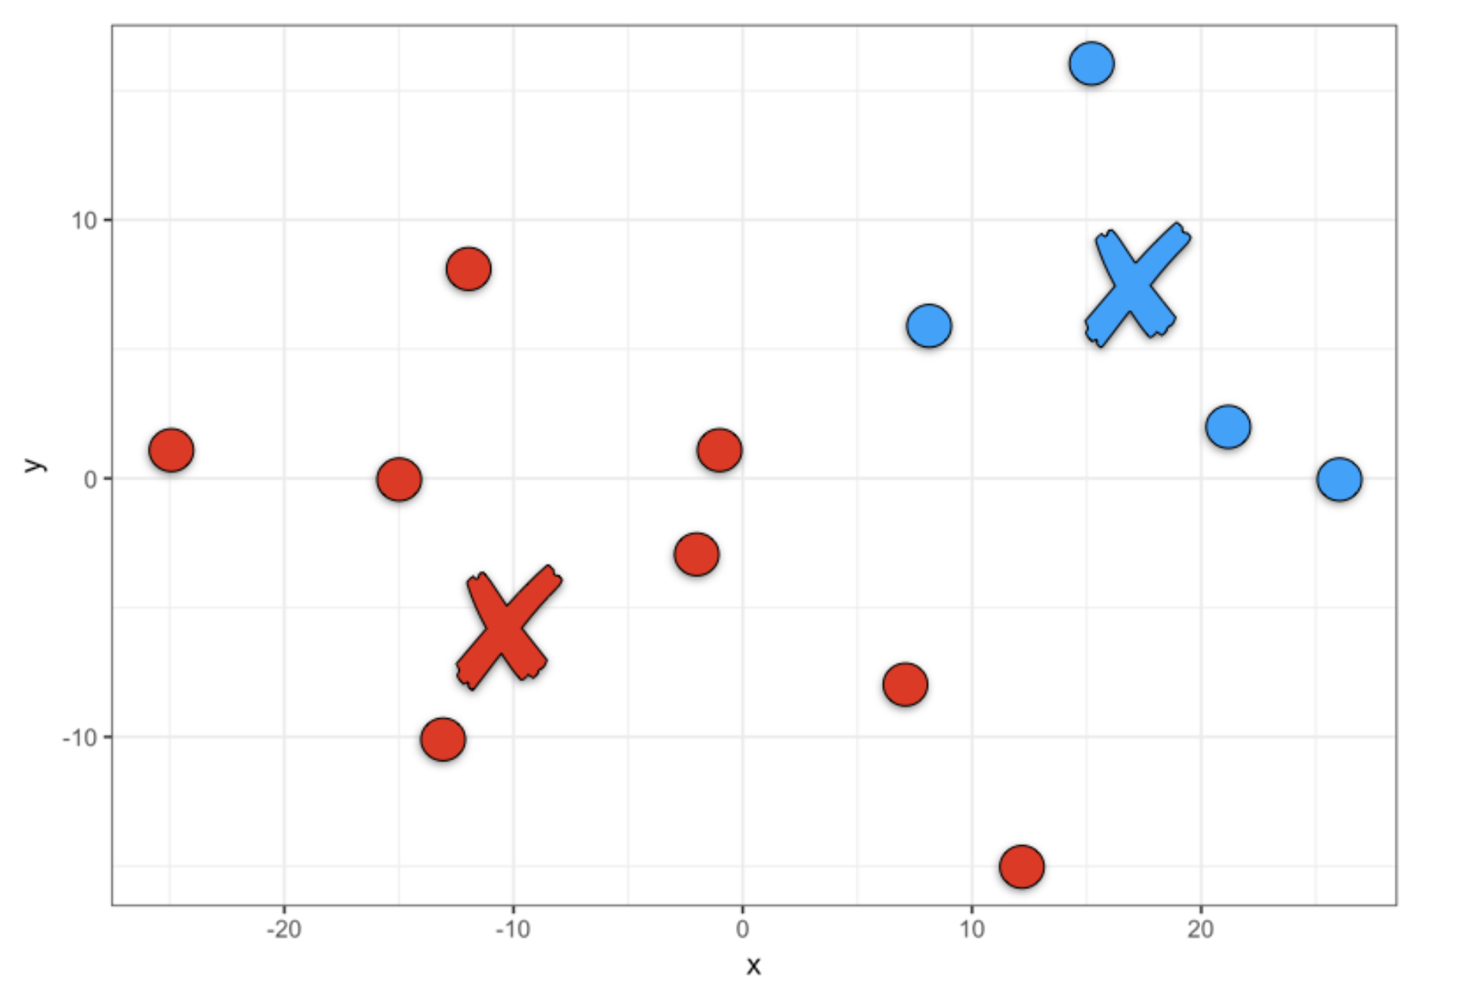
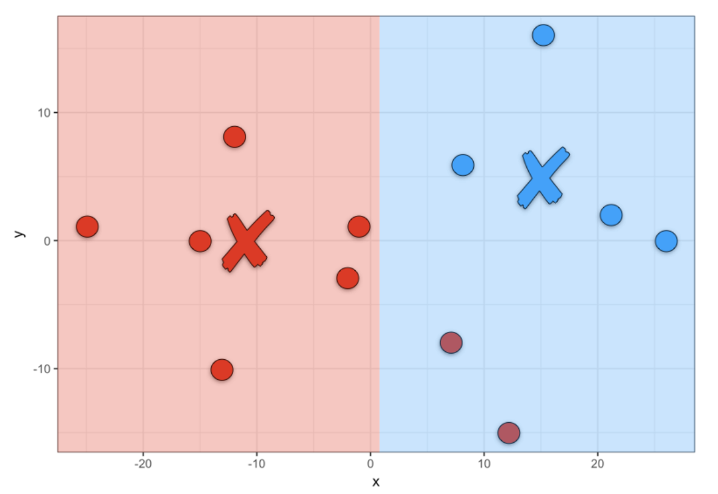
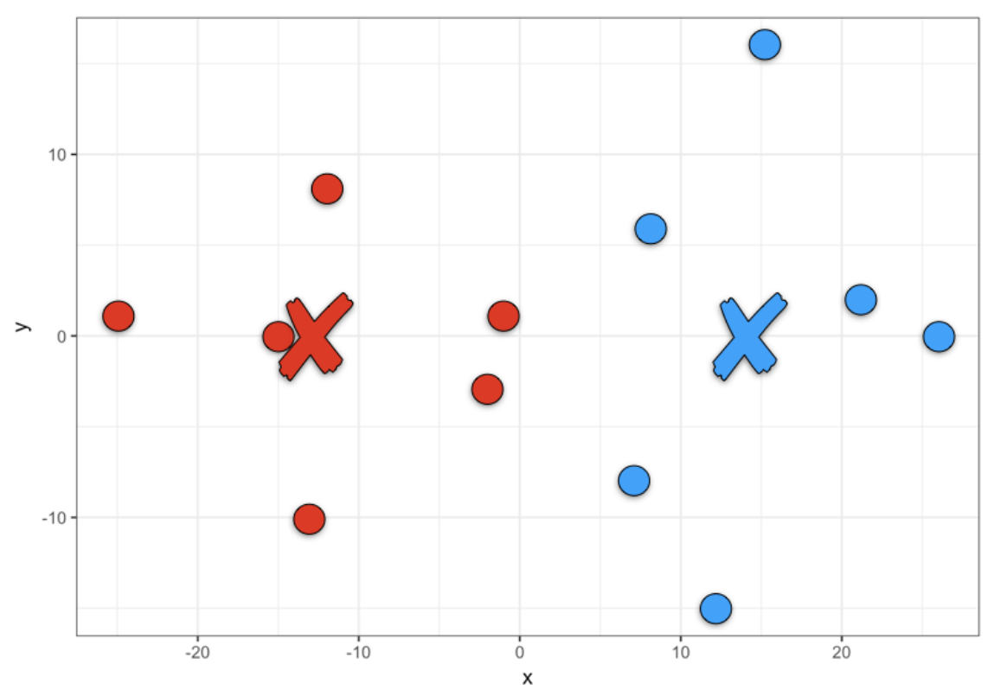
K-Means Clustering

Slide 21

K-Means Clustering - interpretation
Interpreting the results
Typically, as a result of k-means clustering analysis, we examine the means for each cluster in each dimension to estimate how different our clusters are from each other. Ideally, we would get very different means for most, if not all, of the dimensions included in the analysis. The size of the F-statistic from the analysis of variance performed in each dimension is an indicator of how well a given dimension discriminates against clusters.

Slide 22
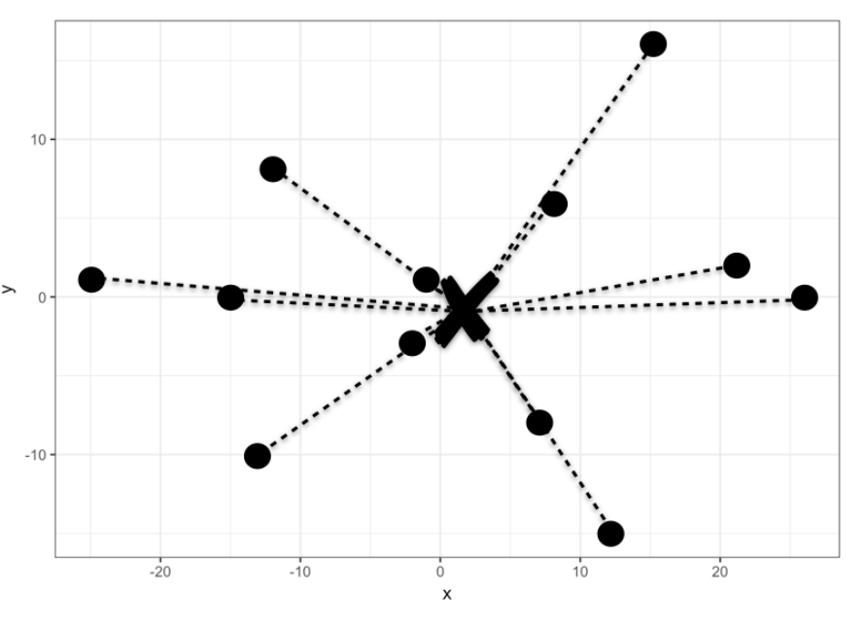
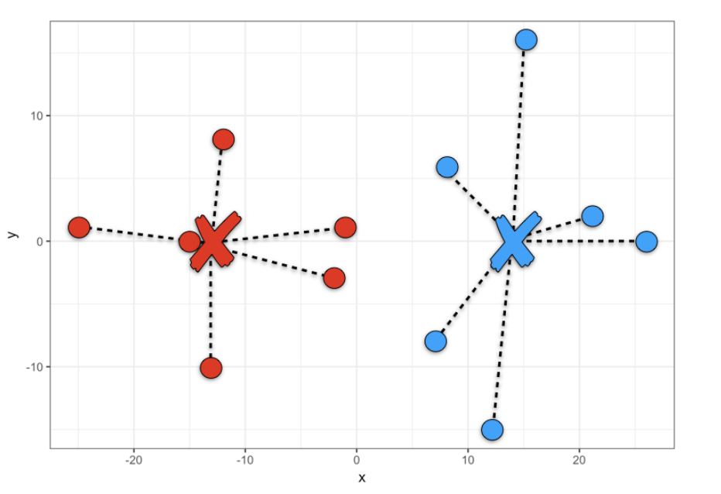
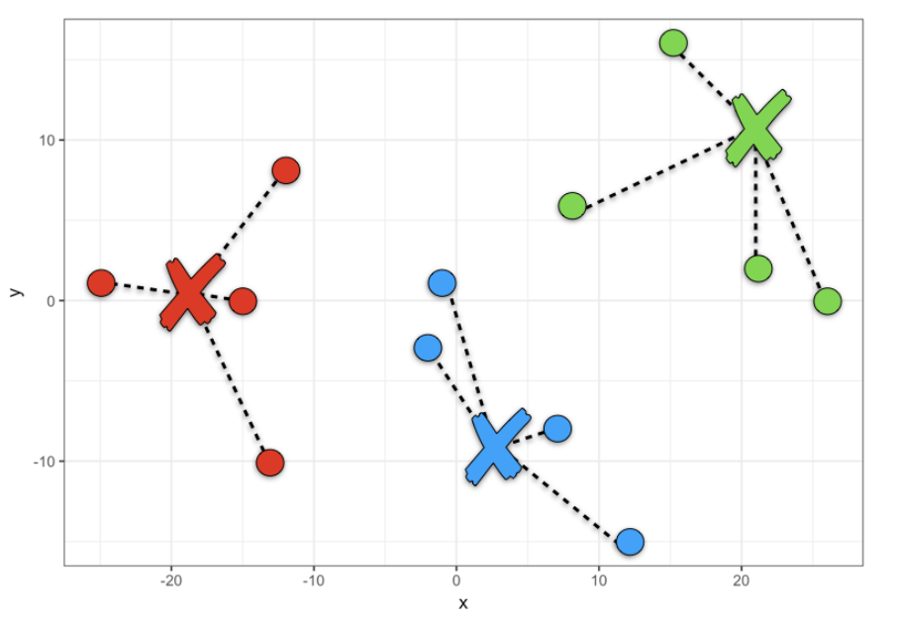
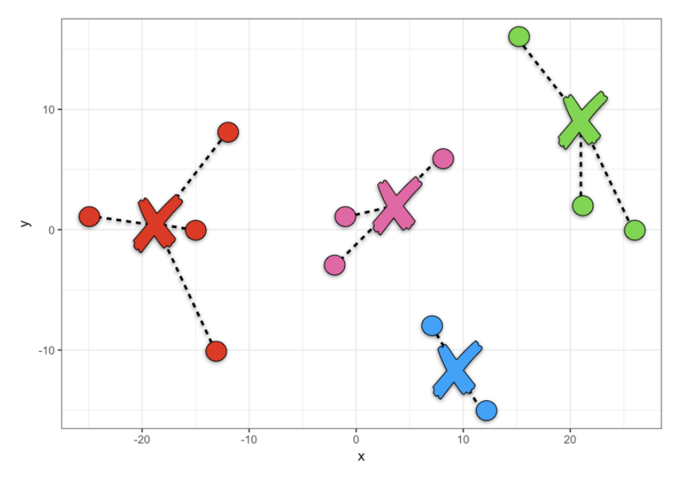
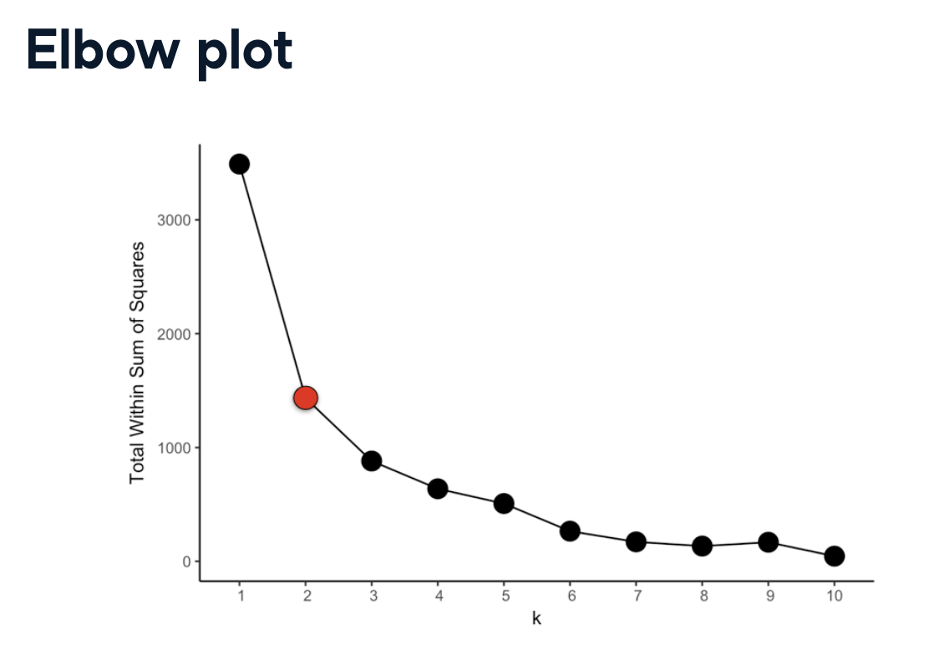
Evaluating different values of K by eye (elbow method)

Slide 23
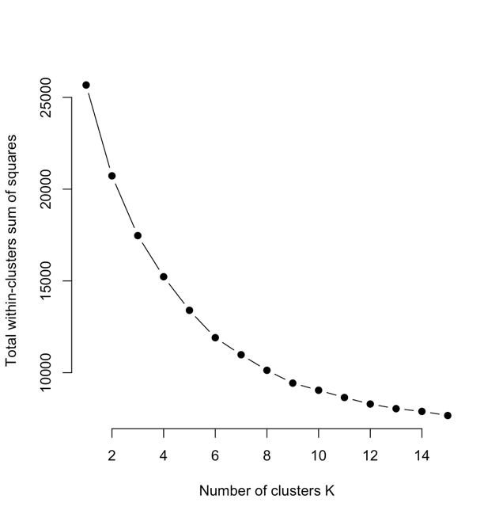
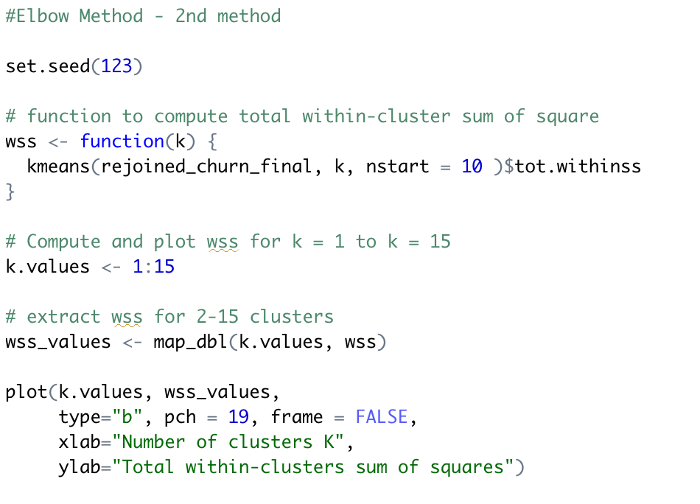
Cluster analysis
Elbow method

Slide 24
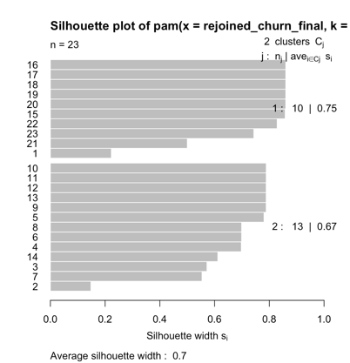
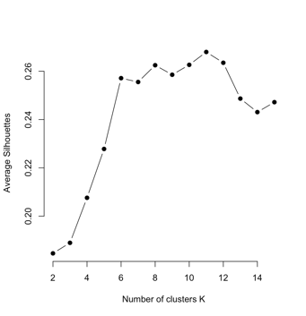
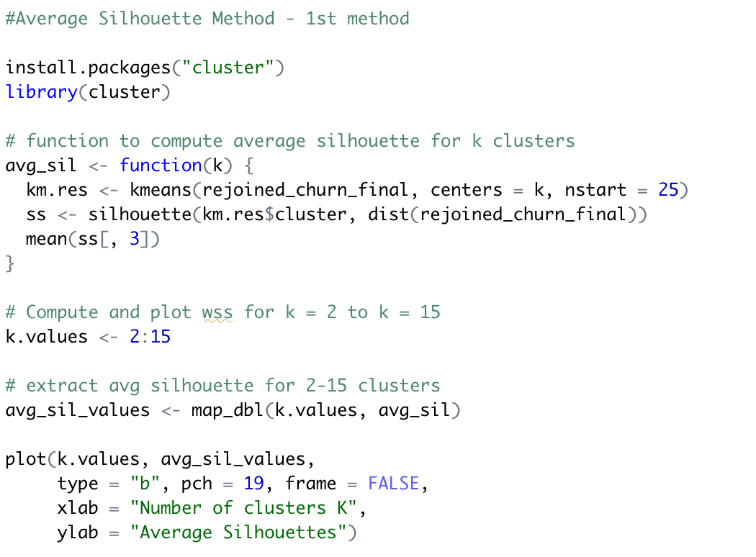
Cluster analysis
Silhouette method

Slide 25
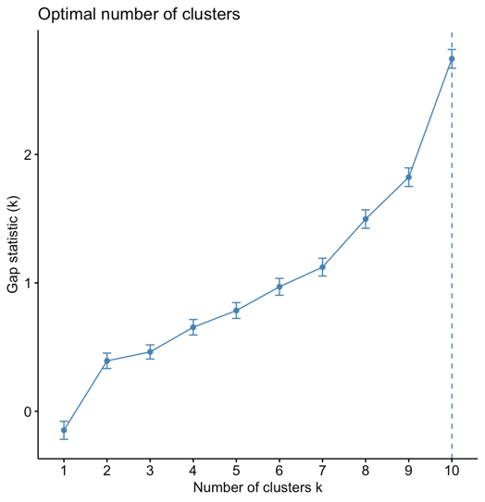
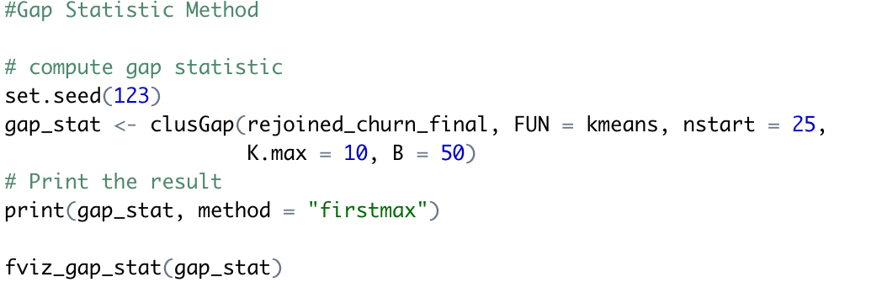
Cluster analysis
Gap Statistic Method

Slide 26
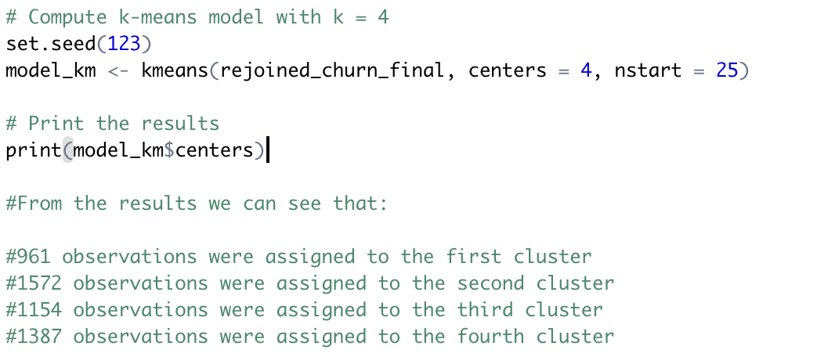
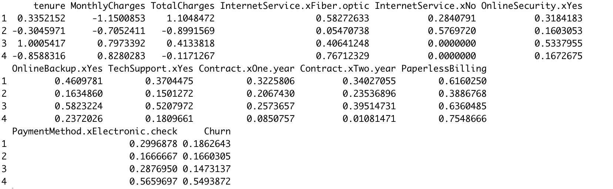
K-means model
Cluster means

Slide 27
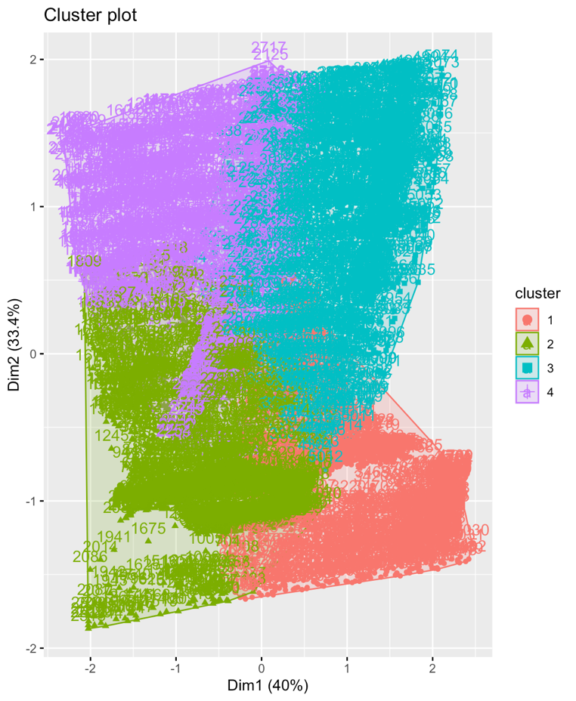
K-means clustering in R
Cluster plot

Slide 28


Hierarchical Clustering
Dendrogram

